Slide 1




NEXT GEN EMPLOYABILITY PROGRAM
Creating a future-ready workforce
Team Members
College Name
Student Name :Harish kumar k
Student ID :au622021104035
Paavai college of engineering
namakkal

Slide 2

CAPSTONE PROJECT SHOWCASE
Project Title
Building Bus Reservation System using Python and Django
Abstract | Problem Statement | Project Overview | Proposed Solution | Technology Used | Modelling & Results | Conclusion

Slide 3
Abstract
Setup Django Project:
Install Django using pip.
Create a new Django project using django-admin startproject project_name.
Create a new Django app for the reservation system using python manage.py startapp reservation.
Design Database Models:
Define Django models for buses, routes, reservations, users, and other relevant entities.
Consider the relationships between these models (e.g., a reservation belongs to a user and a bus).
Source :

Slide 4
Problem Statement
Define Requirements: Clearly outline the requirements of the bus reservation system. This includes understanding user roles, features such as booking, cancellation, seat selection, payment processing, etc.
Database Design:
Identify the entities: Buses, Routes, Users, Reservations, etc.
Define the attributes and relationships between these entities.
Choose appropriate Django model fields (CharField, IntegerField, ForeignKey, etc.) to represent the data.
Source :

Slide 5


Technology Used
Front-end
Back-end
Source :

Slide 6
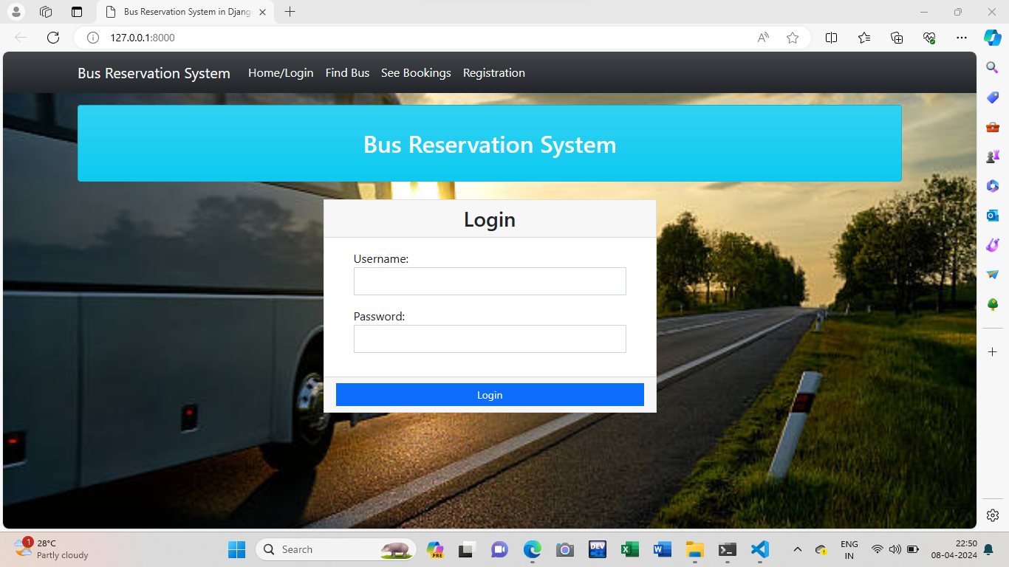
Home
Source :

Slide 7
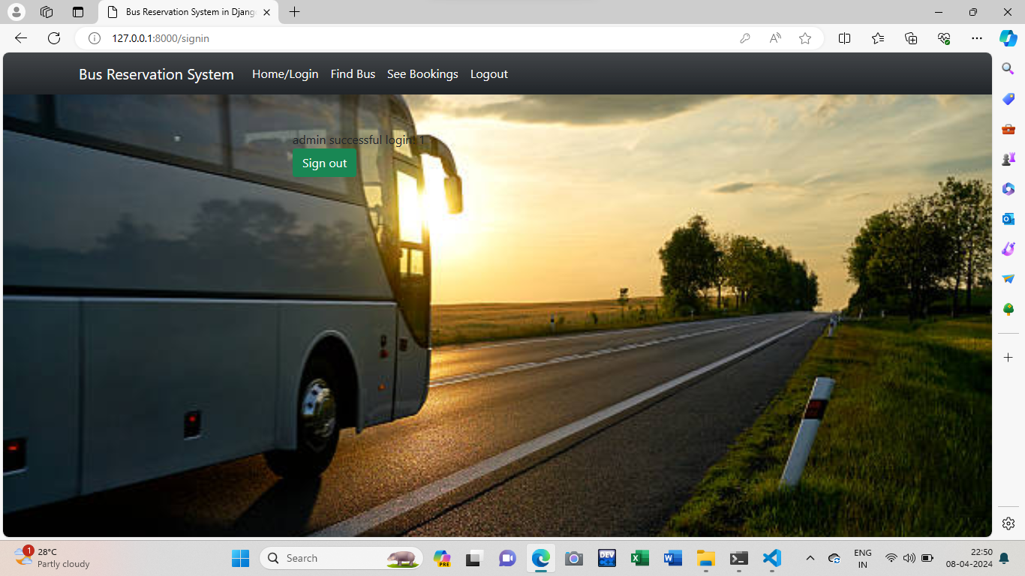
Admin

Slide 8
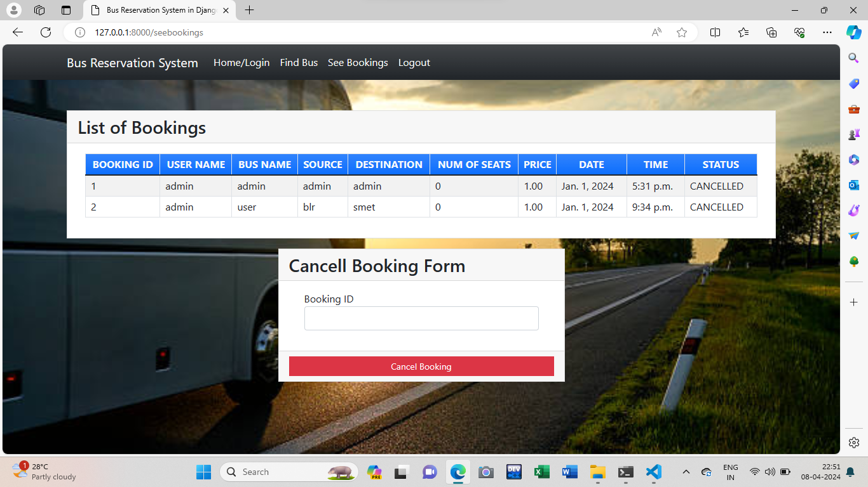
Bus booking Page

Slide 9
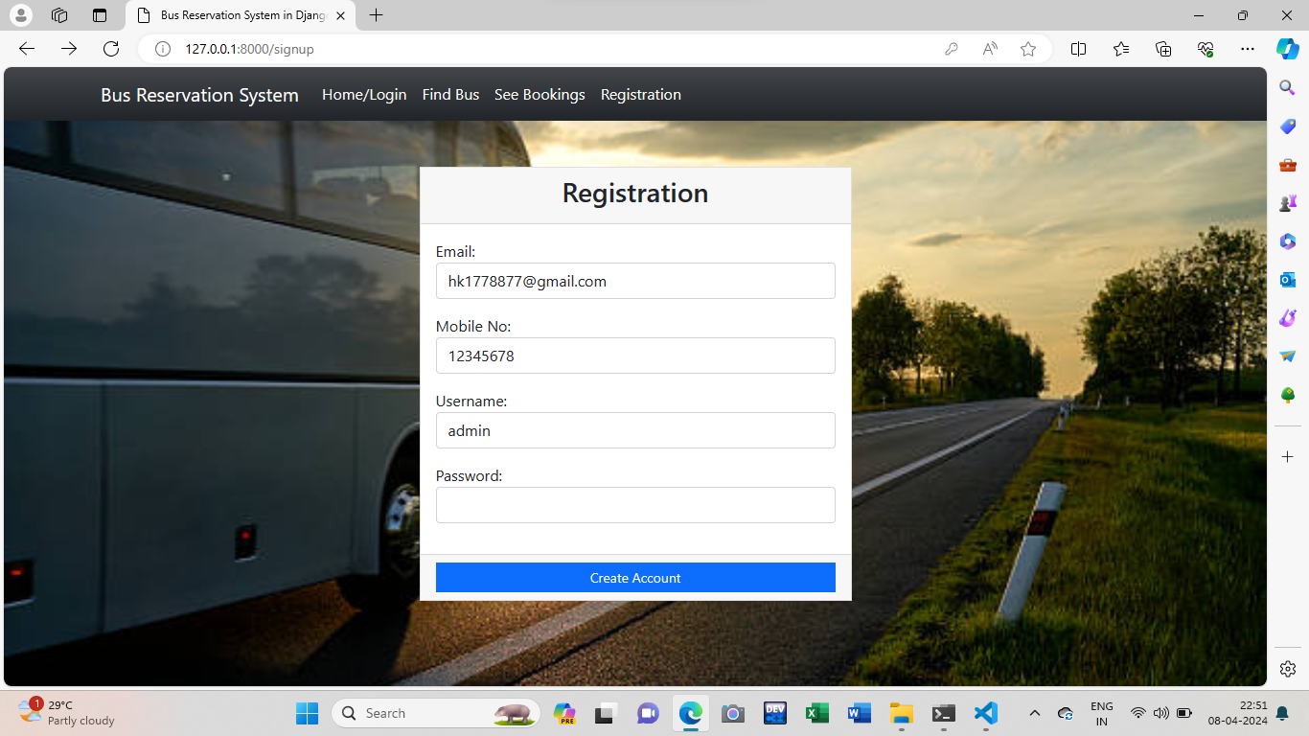
regestration-Page

Slide 10
Thank You!
Notes:
Thank You !!

